Slide 1
CSE251: Electronic Devices and Circuits
Lecture: 14 - 16 – MOSFET
Prepared By:
Shadman Shahid (SHD)
Lecturer, Department of Computer Science and Engineering, School of Data and Sciences, BRAC University
Email: ext.shadman.shahid@bracu.ac.bd

Slide 2
Outline
Introduction to Electronic Switches
Basic Inverter
Introduction to Controlled Sources
Introduction to MOSFET
MOSFET as digital switch
Designing Logic gates with MOSFETs

Slide 3
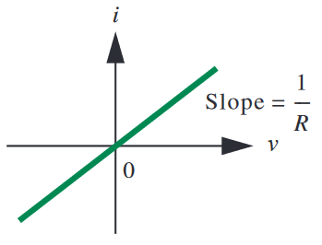
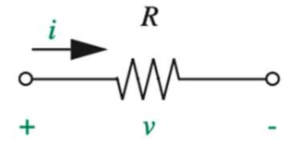
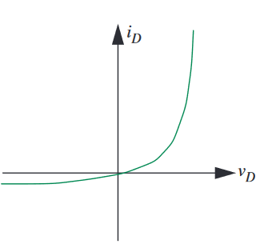
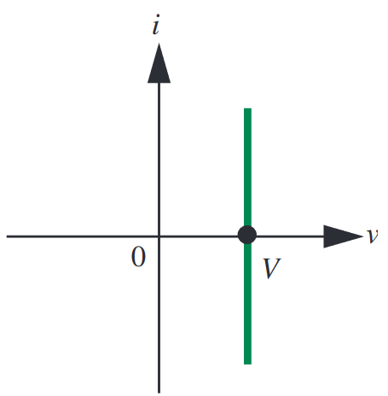
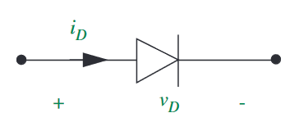
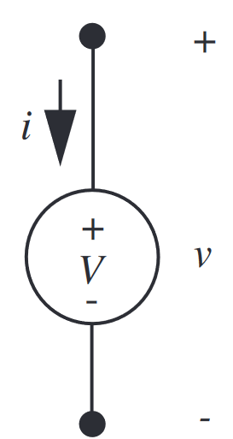
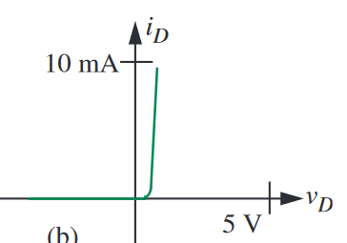
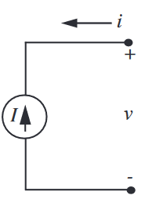
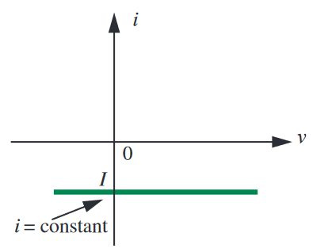
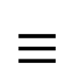



Two terminal Devices
Linear Devices
IV characteristics of two terminal devices are fixed.
Resistor
Non-linear Devices
$$≡$$
Diode
Voltage Source
Actual IV
$$≡$$
$$≡$$
PWL: Piecewise Linear
PWL IV
Current Source
$$≡$$
IV characteristics of three terminal devices can be changed

Slide 4
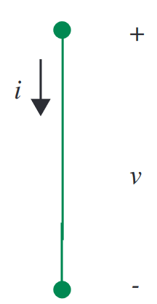
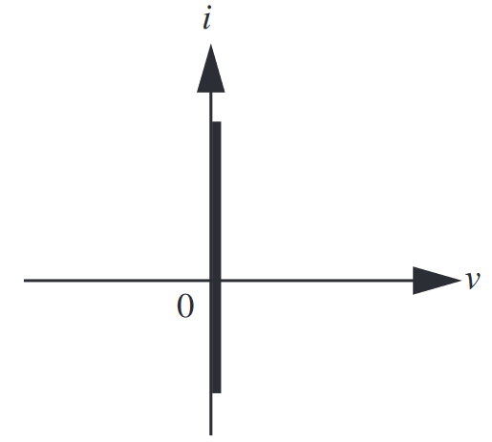
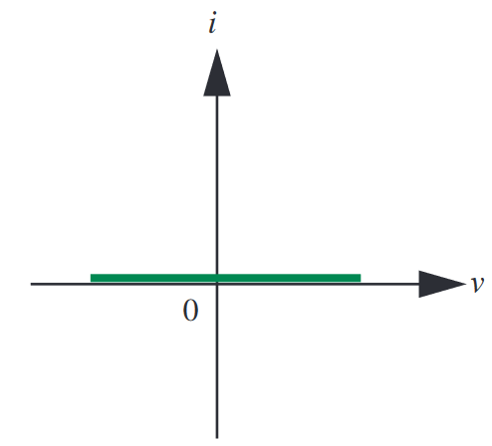
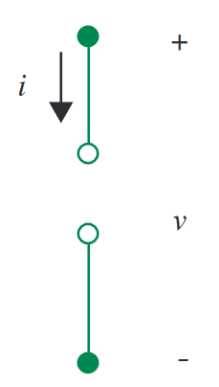
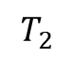
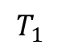
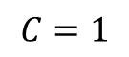
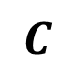
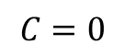
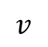
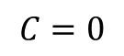
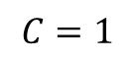
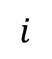
Three terminal Devices
IV of two terminal can be controlled using a third terminal.
Example: Switch, MOSFET, BJT
$$C$$
Control Signal (Physical/Voltage/Current)
Switch
$$T_{1}$$
$$T_{2}$$
IV characteristics between $T_{1}$ and $T_{2}$ can be controlled by $C$
$$i$$
$$C=1$$
$$C=1$$
$$C=0$$
$$C=0$$
$$v$$
Switch ON
Switch OFF

Slide 5
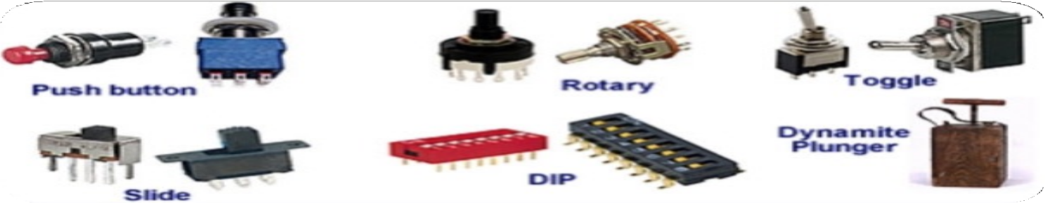
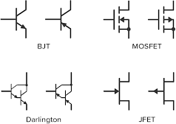
Switch – Types
Depending on the control, the switch can be
Analog: Controlled using physical toggle/button
Digital: Controlled using voltage or current. Example – MOSFET (voltage controlled), BJT (current controlled)
Analog switches
Digital switches (Transistors)

Slide 6
Digital Representation
Binary → Two states (0/False, 1/True)
Binary variables in circuit, need to use two states of device/parameters
We use this convention usually
Voltage |  | Current |  |  |  | State
5V → | 1 |  | 2mA | → | 1 | ON → | 1
0V → | 0 |  | 3mA | → | 0 | OFF → | 0
0V → 1 3.3V → 0 |  |  |  |  |  | Low resistance High resistance
Diode
Memristor
→ 1
→ 0

Slide 7
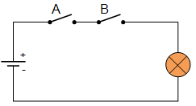
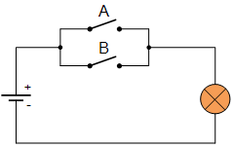
Switch Application – Logic Gates
We can use switches to build logic gates
A | B | Bulb
0 | 0 | OFF
0 | 1 | OFF
1 | 0 | OFF
1 | 1 | ON
AND operation
A | B | Bulb
0 | 0 | OFF
0 | 1 | ON
1 | 0 | ON
1 | 1 | ON
OR operation

Slide 8
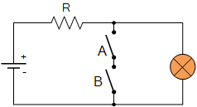
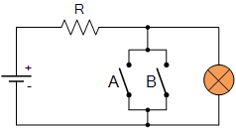
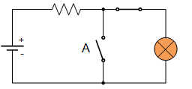
Switch Application – Logic Gates
A | Bulb
0 | ON
1 | OFF
A | B | Bulb
0 | 0 | ON
0 | 1 | ON
1 | 0 | ON
1 | 1 | OFF
A | B | Bulb
0 | 0 | ON
0 | 1 | OFF
1 | 0 | OFF
1 | 1 | OFF
NOT operation NAND operation NOR operation
These circuits are “preferred” – because they can be cascaded to build combinational logic circuits
-> if we remove the bulb and use the voltage across instead to cascade and drive the next gate

Slide 9
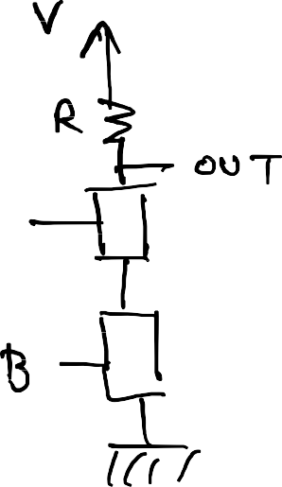
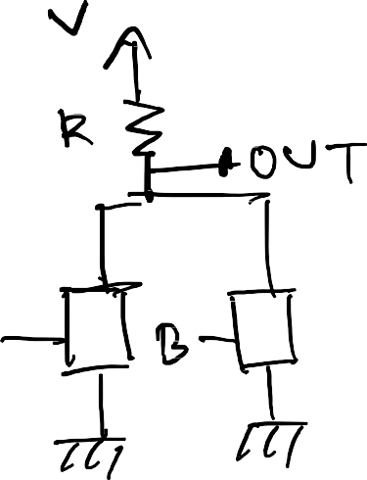
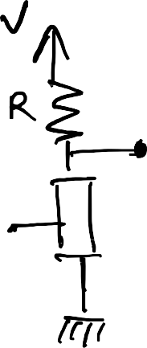
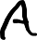
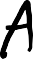
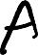
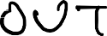
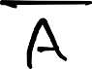
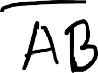
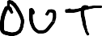
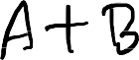
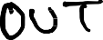
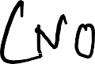
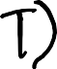
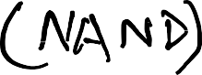
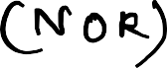
Switch Application – Logic Gates
Alternative representations:

Slide 10
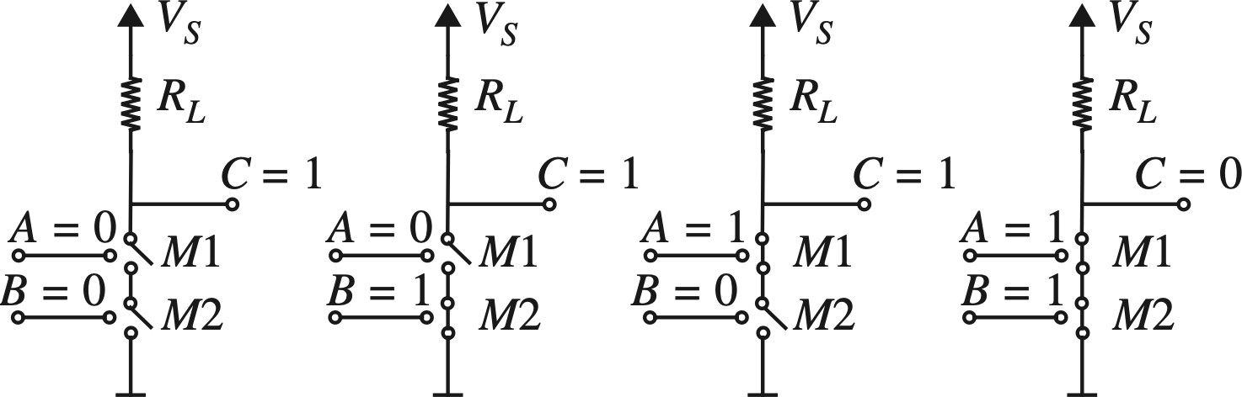



Switch Application – Logic Gates
Alternative representations:

Slide 11





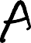





Switch Application – Logic Gates
𝐴 | ^{𝑉}𝑶𝑼𝑻
0 | 5V
1 | 0V
𝐴 | 𝑩 | ^{𝑉}𝑶𝑼𝑻
0 | 0 | 5V
0 | 1 | 5V
1 | 0 | 5V
1 | 1 | 0V
𝐴 | 𝑩 | ^{𝑉}𝑶𝑼𝑻
0 | 0 | 5V
0 | 1 | 0V
1 | 0 | 0V
1 | 1 | 0V

Slide 12
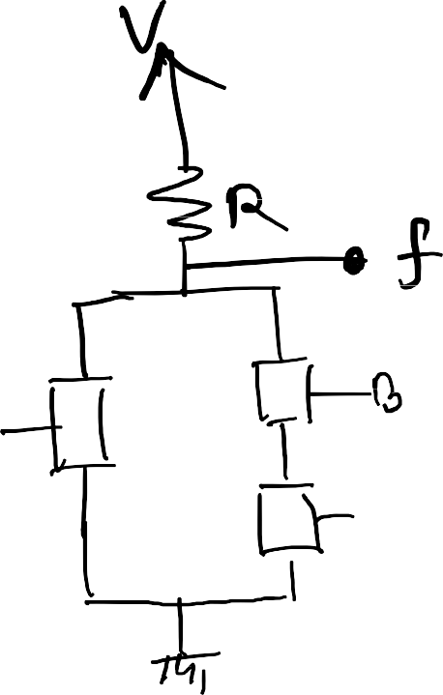
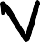














Examples

Slide 13




Example
Implement using switches: 𝑓 = (𝐴 + 𝐵)𝐶

Slide 14









Practice Problem 1
In digital systems, binary data may be subjected to noise that can alter a 0 to a 1 or a 1 to a 0.
A simple way to check if any error has occurred is to use an even parity checker. If there are two input bits $x$ and $y$, the output of the even parity checker (denoted as $f$) will be HIGH if there are even number of 1s, i.e., if both x and y are 0 or if both of them are 1.
$$x$$ | $$y$$ | $$f$$
0 | 0 | 1
0 | 1 | 0
1 | 0 | 0
1 | 1 | 1
$f=x⋅y+\overline{x}⋅\overline{y}=\overline{\overline{x⋅y+\overline{x}⋅\overline{y}}}$
$=\overline{\overline{x.y}⋅\overline{\overline{x}⋅\overline{y}}}$

Slide 15





Digital Representation
Suppose you want to send 010110
Single value based representaion fails in the presence of noise
Better approach – threshold-based system
Simplest: Logical 0 $= V <V_{T}$ Logical 1 $= V > V_{T}$

Slide 16





Static Discipline
Specification for “all” digital devices
Requires devices to adhere to common representation to ensure that
valid input produces valid output
This means, if
Sender sends “0” Receiver interprets as “0”
Sender sends ”1”
Receiver interprets as “1”

Slide 17




Static Discipline
Naïve approach: Single threshold-based system
Channel
$$V_{T}= 2.5 V$$
5V
Valid 1
1
1
sender
receiver
sender
receiver
Logical 0: $V_{o}<V_{T}$
Logical 1:$V_{o}>V_{T}$
Logical 0: $V_{i}<V_{T}$
Logical 1: $V_{i}>V_{T}$
Device/Gate
2.5V
Device/Gate
Valid 0
0
0
What if $V_{i}= 2.5 V$? It is undefined!
0V

Slide 18






Static Discipline
Double threshold based system
$V_{H}$= High voltage threshold = 3𝑉
Channel
5V
$V_{L}$= High voltage threshold = 2 𝑉
Valid 1
Forbidden Region
Valid 0
1
1
sender
receiver
3V
Logical 0: $V_{o} < V_{L}$
Logical 1:$V_{o}>V_{H}$
Logical 0: $V_{i}<V_{L}$
Logical 1: $V_{i}>V_{H}$
sender
receiver
Device/Gate
Device/Gate
2V
0
0
What if $V_{o}=$1.9𝑉 and channel noise is 0.5𝑉?
$V_{i}$= 1.9𝑉 + 0.5𝑉 = 2.4𝑉 = invalid
➔ valid output producing invalid input, i.e., no margin for noise
0V

Slide 19





Static Discipline
Four threshold-based system → Tighter restriction on sender (output)
$V_{OH}$= Output high voltage threshold = 4.5𝑉
$V_{OL}$ = Output low voltage threshold = 0.5𝑉
$V_{IH}$ = Input high voltage threshold = 3𝑉
$V_{IL}$= Input low voltage threshold = 2𝑉
Channel
5V
Valid 1
NM₁
Forbidden Region
NM₀
Valid 0
1
4.5V
3V
1
sender
receiver
sender
receiver
Device/Gate
Device/Gate
Logical 0: $V_{o} < V_{OL}$
Logical 1:$V_{o}>V_{OH}$
Logical 0: $V_{i}<V_{IL}$
Logical 1: $V_{i}>V_{IH}$
2V
0.5V
0
0
For static discipline, ${{{V_{OL}<V}_{IL}<V}_{IH}<V}_{OH}$
0V
Noise margins (NM):
$NM_{1}=V_{OH}−V_{IH}= 4.5 − 3 = 1.5 V$ (significance?)
$NM_{0}=V_{IL}−V_{OL}=2 −0.5 = 1.5 V$ (significance? )

Slide 20


Static Discipline
Four threshold-based system → Tighter restriction on sender (output)
$V_{OH}:$The lowest output voltage value that a digital device can produce when it outputs a logical 1.
$V_{OL}:$ The highest output voltage value that a digital device can produce when it outputs a logical 0.
$V_{IH}:$ The lowest input voltage value that a digital device must recognize as a logical 1.
$V_{IL}:$ The highest input voltage value that a digital device must recognize as a logical 0.

Slide 21


Static Discipline and VTC graph
Four threshold-based system → Tighter restriction on sender (output)
During high to low or low to high transition:
$$\frac{ΔV_{O}}{ΔV_{I}}=\frac{V_{OH}−V_{OL}}{V_{IH}−V_{IL}}>1$$
Higher Slope in VTC graph
While not in transition; at logical HIGH or LOW voltage level:
$$\frac{ΔV_{OL}}{ΔV_{IH}}=\frac{V_{OL}−0}{5−V_{IH} }<1$$
$$\frac{ΔV_{OH}}{ΔV_{IL}}=\frac{5−V_{OH}}{V_{IL}−0}<1$$
Smaller Slope in VTC graph

Slide 22


Static Discipline and VTC graph
During high to low or low to high transition:
$$\frac{ΔV_{O}}{ΔV_{I}}=\frac{V_{OH}−V_{OL}}{V_{IH}−V_{IL}}>1$$
Slope
Forbidden
Region
Forbidden
Region
While not in transition; at logical HIGH or LOW voltage level:
$$\frac{ΔV_{OL}}{ΔV_{IH}}=\frac{V_{OL}−0}{{5−V}_{IH}}<1$$
$$\frac{ΔV_{OH}}{ΔV_{IL}}=\frac{5−V_{OH}}{V_{IL}−0}<1$$
Slope
Slope

Slide 23




Transistors as Digital Switch
Transistors are 3 terminal non-linear devices, can be used as switch
2 types – Voltage Controlled, Current Controlled
Metal Oxide Semiconductor Field Effect Transistor (MOSFET) are voltage controlled
Control, $C=V_{GS}$. The IV characteristics ($I_{DS}$ vs $V_{DS}$) depends on $V_{GS}$
Actual dependency is complex.
Will start with a simple (but approximate) one – S-Model (Switch Model)

Slide 24



MOSFET S-Model
The MOSFET (approximately) behaves like a switch
$C=V_{GS}$. Here, $C = “0” ⇒ V_{GS}<V_{T}$, and $C=“1”⇒ V_{GS}>V_{T}$

Slide 25


MOSFET S-Model

Slide 26



Logic Gates using MOSFET
Just replace the switches with MOSFETs!
NOT Gate (Inverter)
NAND Gate (Inverter)
NOR Gate (Inverter)

Slide 27


MOSFET Logic Gates – More Examples
Vs
Vs
Vs
𝑂𝑈𝑇 = 𝐴𝐵 + 𝐶 + 𝐷
𝑂𝑢𝑡 =
𝐴 + 𝐵 𝐶𝐷 =
𝐴 + 𝐵 𝐶𝐷

Slide 28




Practice Problem 2
Design a circuit using ideal MOSFETs (S-model) to implement the logic function
$f=\overline{AC}+\overline{(B+C)}$
$=\overline{\overline{\overline{AC}+\overline{(B+C)}}}$
$=\overline{\overline{\overline{AC}}⋅\overline{\overline{(B+C)}}}$ [De Morgan’s Theorem]
$=\overline{AC⋅(B+C)}$

Slide 29


Practice Problem 1
In digital systems, binary data may be subjected to noise that can alter a 0 to a 1 or a 1 to a 0.
A simple way to check if any error has occurred is to use an even parity checker. If there are two input bits $x$ and $y$, the output of the even parity checker (denoted as $f$) will be HIGH if there are even number of 1s, i.e., if both x and y are 0 or if both of them are 1.
$$x$$ | $$y$$ | $$f$$
0 | 0 | 1
0 | 1 | 0
1 | 0 | 0
1 | 1 | 1
$f=x⋅y+\overline{x}⋅\overline{y}=\overline{\overline{x⋅y+\overline{x}⋅\overline{y}}}$
$=\overline{\overline{x.y}⋅\overline{\overline{x}⋅\overline{y}}}$

Slide 30






Voltage Transfer Characteristics (VTC)
Reminder: VTC is a graph where $x−$axis = input voltage, $y$-axis = output voltage
Why? Design logic gates to follow a given static discipline
When $v_{IN}<V_{T}$ (Logical 0) $v_{OUT}=V_{S}=5 V$ (Logical 1)
When $v_{IN}≥V_{T}$ (Logical 1) $v_{OUT}=0 V$ (Logical 0)

Slide 31






VTC of NAND gate
We only have one $x−$axis, but two inputs
Solution: Draw two VTC, one considering $V_{A}=0$ one considering $V_{A}=1$
When $V_{A}= 0$
When $V_{A}=1$

Slide 32


VTC of NAND gate
We only have one $x−$axis, but two inputs
Solution: Draw two VTC, one considering $V_{A}=0$ one considering $V_{A}=1$
𝑉_{Y} = 0
𝑉_{Y} = 1
When $V_{A}= 0$
When $V_{A}=1$
Homework: Find VTC for NOR gate

Slide 33
Outline
Constructing a *real* MOSFET – n/p-channel
Operation of an MOSFET-
Cut-Off
Saturation
Triode Mode
Output Characteristics
PWL Model and Non-ideal Analysis: SR model
Real MOSFET equations
Introduction to Static analysis

Slide 34

Construction of Real MOSFET
Top view of several n-channel MOSFETs fabricated on a chip. The square MOSFETs in the center of the photograph have a width and length of 100 μm. (Photograph Courtesy of Maxim Integrated Products.)
100
𝜇𝑚

Slide 35


Real MOSFET – Enhancement Type
Device Structure (n-channel MOSFET)

Slide 36
n-channel MOSFET (NMOS) Physical Structure
Enhancement Type
gate
source
drain
metal
metal
oxide insulator
metal
n-type
n-type
e
e
e
h
h
e
e
e
p-type
h
h
h
h
metal

Slide 37
NMOS in Equilibrium
gate
source
drain
metal
metal
oxide insulator
metal
n-type
h
_
n-type
+
+
+
_
+
+
+
h
_
_
_
_
p-type
h
h
metal
When the transistor is left alone, some electrons from the n-type wells diffuse into the p-type material to fill holes.
This creates negative ions in the p-type material and positive ions are left behind in the n-type material.

Slide 38
NMOS in Cutoff
V_{GS} > 0
gate
+
-
source
drain
metal
metal
oxide insulator
metal
n-type
_
_
_
_
n-type
+
+
+
_
+
+
+
_
_
_
_
p-type
h
h
h
h
h
metal
When a small, positive V_{GS} is applied, holes “move away” from the gate.
Electrons from complete atoms elsewhere in the p-type material move to fill holes near the gate instead.

Slide 39
NMOS Transistor channel
V_{GS} > V_{TH(n)}
gate
+
-
source
drain
metal
metal
oxide insulator
metal
n-type
e
e
_
_
e
_
e
_
n-type
+
+
+
_
e
+
+
+
_
_
_
_
p-type
h
h
h
h
h
h
h
h
h
h
metal
When V_{GS} is larger than a threshold voltage V_{TH(n)}, the attraction to the gate is so great that free electrons collect there.
The applied V_{GS} creates an induced n-type channel under the gate (an area with free electrons).

Slide 40
NMOS Transistor Drain Current
+
-
V_{GS} > V_{TH(n)}
V_{DS} > 0
gate
+
-
source
drain
metal
metal
oxide insulator
metal
n-type
e
e
_
e
_
e
_
e
_
n-type
+
+
+
_
+
+
+
_
_
_
_
p-type
h
h
h
h
h
h
h
h
h
h
metal
When a positive V_{DS} is applied, the free electrons flow from the source to the drain. (Positive current flows from drain to source).
The amount of current depends on V_{DS}, as well as the number of electrons in the channel, channel dimensions, and material.

Slide 41
NMOS Transistor Circuit symbol
V_{DS}
+
-
V_{GS}
drain
gate
I_{D}
+
-
I_{G}
source
metal
metal
oxide insulator
metal
n-type
n-type
p-type
metal
G
+
V_{GS}
_
I_{G}
I_{D}
S
- V_{DS} +
D

Slide 42
NMOS I-V Characteristic
G
+
V_{GS}
_
I_{G}
I_{D}
S
- V_{DS} +
D
Since the transistor is a 3-terminal device, there is no single I-V characteristic.
Note that because of the insulator, I_{G} = 0 A.
We typically define the MOS I-V characteristic as
I_{D} vs. V_{DS} for a fixed V_{GS}.
The I-V characteristic changes as V_{GS} changes.

Slide 43
Modes of Operation
For small values of V_{GS}, V_{GS} ≤ V_{TH(n)}, the n-type channel is not formed. No current flows. This is cutoff mode.
When V_{GS} > V_{TH(n)}, current I_{D} may flow from drain to source, and the following modes of current flow are possible.
The mode of current flow depends on the propelling voltage, V_{DS}, and the channel-inducing voltage,
V_{GS} – V_{TH(n)}.
When V_{DS} < V_{GS} – V_{TH(n)}, current is starting to flow. I_{D} increases rapidly with increased V_{DS}. This is triode mode.
When V_{DS} ≥ V_{GS} – V_{TH(n)}, current is reaching its maximum value. I_{D} does not increase much with increased V_{DS}. This is called saturation mode.

Slide 44
Water Tap Analogy
Imagine the water tap on your kitchen sink.
To make water flow, the water supply has to be connected to the water tap. This establishes a path for water to flow.
Setting V_{GS} above the threshold voltage is like connecting the water supply.
Cutoff = water supply disconnected (no path for current flow)
Setting V_{GS} to a larger value is like connecting a high-pressure water supply—more flow can potentially occur.

Slide 45
Water Tap Analogy
The water tap itself is used to adjust water flow. You can turn the flow up and down.
V_{DS} is like the water tap. It controls the amount of flow.
There is, of course, a saturation point. If you keep turning the water tap control, eventually you won’t get any more flow.
Triode = water tap in “normal range”, controls flow
Saturation = water tap turned up to (or past) point for maximum flow

Slide 46






NMOS Equations
Cutoff Mode
Occurs when $v_{GS}<V_{T}$
$ID = 0$
Triode Mode
Occurs when $v_{GS}≥V_{T}$and $v_{DS} < vGS − V_{T}$
Saturation Mode
Occurs when $vGS > VT$ and $vDS ≥ vGS − VT$
$v_{GS}−V_{T}=V_{OV}$: Overdrive Voltage
$$V_{OV}$$
Indicates the available excess voltage at gate after forming the n-channel.
$$I_{DS}=k_{n}^{′}\frac{W}{L}\left(v_{GS}−V_{T}−\frac{1}{2}v_{DS}\right)v_{DS}$$
$$V_{T}$$
The minimum voltage necessary at the gate terminal to form a channel.
$$I_{DS}=\frac{1}{2}k_{n}^{′}\frac{W}{L}{\left(v_{GS}−V_{T}\right)}^{2}$$

Slide 47





Real MOSFET
$$k_{n}=k_{n}^{′}\frac{W}{L}$$
MOSFET transconductance
$v_{GS}$: Gate Voltage
$v_{DS}:$ Drain to Source Voltage
$V_{T}$: Threshold Voltage
$V_{OV}=v_{GS}−V_{T}:$ Overdrive voltage

Slide 48





NMOS Triode Mode
Occurs when $v_{GS}≥V_{T}$and $v_{DS} < vGS − V_{T}$
$$I_{DS}∝k_{n}^{′}$$
$$I_{DS}∝\frac{W}{L}$$
$I_{DS}∝$ ${(V}_{OV}−\frac{1}{2}v_{DS})$
$$I_{DS}=k_{n}\left(v_{GS}−V_{T}−\frac{1}{2}v_{DS}\right)v_{DS}$$
Overdrive Voltage is defined as:
$V_{OV}=v_{GS}−V_{T}$
In triode mode, average voltage across channel is actually:
($V_{OV}−\frac{1}{2}v_{DS}$)

Slide 49




NMOS Saturation mode
Occurs when $vGS > V_{T}$ and $vDS ≥ v_{GS} − V_{T}$
$$I_{DS}∝k_{n}^{′}$$
$$I_{DS}∝\frac{W}{L}$$
$$I_{DS}=\frac{1}{2}k_{n}{\left(v_{GS}−V_{T}\right)}^{2}=\frac{1}{2}k_{n}V_{OV}^{2}$$
Overdrive Voltage is defined as:
$V_{OV}=v_{GS}−V_{T}$
In Saturation mode, average voltage across channel fixed at:
$\frac{1}{2}V_{OV}$

Slide 50

Solving Circuits with MOSFET
Use Method of Assumed State!
Three steps:
Assume: One of the modes (Cutoff, Triode, Saturation)
Solve: Use corresponding equation and KCL+KVL
Verify: Check if the conditions of $V_{DS}$ and $V_{GS}$ are satisfied. If not, repeat.
Might need to solve quadratic equation (𝑎𝑥² + 𝑏𝑥 + 𝑐 = 0).
If we get two roots, choose the one that’s favorable to your assumption

Slide 51



Example 1
Analyze the circuit to find $i_{D}$ and $v_{O2}$ using the Method of Assumed State. Here, the input of the MOSFET is $v_{o1}=1 V$. You must validate your assumptions.
Assume:
Let MOSFET be in Saturation mode:
$v_{o1}<V_{T}$
$vDS ≥ v_{GS} − VT$ or $v_{O2}≥0.8 V$
Solve:
$$v_{o1} − V_{T}=1−0.2=0.8 V$$
Current Equation: $I_{D}=\frac{k}{2}{\left(v_{GS}−V_{T}\right)}^{2}=\frac{4}{2}{\left(0.8\right)}^{2}=1.28 mA$
$$v_{O2}=2−I_{D}=0.72 V$$
Verify: For Saturation mode $→$ $v_{O2}≥0.8 V$
But here, $v_{O2}=0.72 V<0.8 V$
Here, the conditions are NOT fulfilled.
Assumption is INCORRECT!

Slide 52

Example 1
Analyze the circuit to find $i_{D}$ and $v_{O2}$ using the Method of Assumed State. Here, the input of the MOSFET is $v_{o1}=1 V$. You must validate your assumptions.
$∴$ MOSFET is in Triode Mode.
$I_{D}=k\left(v_{GS}−V_{T}−\frac{1}{2}v_{DS}\right)v_{DS}=\frac{2−v_{DS}}{1}$
$$4\left(0.8−\frac{1}{2}v_{O2}\right)v_{O2}=2−v_{O2}$$
$v_{o2}=1.37 V$ or $0.73 V$

Slide 53



Example 2
Design the circuit, that is, determine the values of $R_{D}$ and $R$, so that the transistor operates at $I_{D} = 0.4 mA$and $V_{D} =+0.5 V$. The NMOS transistor has $V_{T}=0.7 V$, $k=3.2 mA/V^{2}$.
$$R_{D}=\frac{V_{DD}−V_{D}}{I_{D}}=\frac{2.5−0.5}{0.4}=5 kΩ$$
Assume:
Let MOSFET be in Saturation mode:
$v_{GS}>V_{T}$
$vDS ≥ v_{GS} − V_{T}$
Solve:
$$v_{GS}=−V_{S}$$
$$V_{GS}−V_{T}=−V_{S}−0.7$$
Current Equation: $I_{D}=\frac{k}{2}{\left(v_{GS}−V_{T}\right)}^{2}=\frac{3.2}{2}{\left(−V_{S}−0.7\right)}^{2}=0.4 mA$
$V_{S}=−0.2 V$ or $−1.2 V$

Slide 54


Example 2
Design the circuit, that is, determine the values of $R_{D}$ and $R$, so that the transistor operates at $I_{D} = 0.4 mA$and $V_{D} =+0.5 V$. The NMOS transistor has $V_{T}=0.7 V$, $k=3.2 mA/V^{2}$.
Verify:
$$V_{DS}=0.5−V_{S}=1.7 V$$
$$V_{GS}−V_{T}=−V_{S}−0.7=0.5 V$$
Clearly $V_{DS}≥V_{GS}−V_{T}$
Assumption is CORRECT!
$$R_{S}=\frac{V_{S}−V_{SS}}{I_{D}}=\frac{−1.2−(−2.5)}{0.4}=5.75 kΩ$$

Slide 55




Example - 3
For the circuit, find the value of $R$ that results in $V_{D}=0.8 V$. The MOSFET has $V_{T}=0.5 V$, $k_{n}^{′}=μ_{n}C_{OX}=0.4 mA/V^{2}$, $\frac{W}{L}=\frac{0.72 μm}{0.18 μm}$
$$k_{n}=k_{n}^{′}\frac{W}{L}=1.6 mA/V^{2}$$
Assume:
Let MOSFET be IS in Saturation mode:
Proof: $V_{D}=V_{G}$
$VD{−V_{S}=V}_{G}−V_{S}$
$V_{DS}=V_{GS}≥ V_{GS} − V_{T} →$Saturation Mode
Solve:
$$V_{GS}−V_{T}=V_{DS}−V_{T}=0.8−0.5=0.3 V$$
Current Equation: $I_{D}=\frac{k_{n}}{2}{\left(V_{GS}−V_{T}\right)}^{2}=\frac{1.6}{2}{\left(0.3\right)}^{2}=0.072 mA$
$$R_{D}=\frac{1.8−V_{D}}{I_{D}}=\frac{1.8−0.8}{0.072}=13.89 kΩ$$

Slide 56

Example - 4

Slide 57

Example - 4
Assume:
Let MOSFET be in Saturation mode:
$V_{GS}<V_{T}$
$VDS ≥ V_{GS} − V_{T}$
Solve:
$$I_{D}=\frac{10−V_{D}}{6}=\frac{V_{S}}{6}$$
Current Equation: $I_{D}=\frac{k}{2}{\left(V_{GS}−V_{T}\right)}^{2}=\frac{1}{2}{\left(5−V_{S}−1\right)}^{2}$
$$I_{D}=\frac{V_{S}}{6}=\frac{1}{2}{\left(4−V_{S}\right)}^{2}$$
$V_{S}=5.33 V$ or $3 V$

Slide 58

Example - 4
Verify:
$$I_{D}=\frac{V_{S}}{6}=\frac{3}{6}=0.5 mA$$
$$V_{D}=10−6I_{D}=7 V$$
$$VDS= V_{D} − V_{S}=7−3=4 V$$
$$V_{GS}−V_{T}=4−V_{S}=1 V$$
For Saturation mode $→$ $VDS ≥ V_{GS} − V_{T}$
Assumption is CORRECT!

Slide 59



Example - 5
Solve:
Both MOSFET are in SATURATION:
Q1: $V_{GS1}−V_{T}=1−V_{T}=1−0.5=0.5 V$
Q2: $V_{GS2}−V_{T}=\left(1.8−1\right)−V_{T}=0.8−0.5=0.3 V$
Current Equation:
$$I_{D}=\frac{μ_{n}C_{ox}}{2}\left(\frac{W_{1}}{L_{1}}\right){\left(V_{GS1}−V_{T}\right)}^{2}=\frac{μ_{n}C_{ox}}{2}\left(\frac{W_{2}}{L_{2}}\right){\left(V_{GS2}−V_{T}\right)}^{2}=0.25 mA$$
$$\frac{0.25}{2}\left(\frac{W_{1}}{0.25}\right){\left(0.5\right)}^{2}=\frac{0.25}{2}\left(\frac{W_{2}}{0.25}\right){\left(0.3\right)}^{2}=0.25$$

Slide 60


Example - 5
$$R=\frac{2.5−1.8}{I_{D}}=2.8 kΩ$$
Solve:
$$I_{D}=\frac{μ_{n}C_{ox}}{2}\left(\frac{W_{1}}{L_{1}}\right){\left(V_{GS1}−V_{T}\right)}^{2}=\frac{μ_{n}C_{ox}}{2}\left(\frac{W_{2}}{L_{2}}\right){\left(V_{GS2}−V_{T}\right)}^{2}=0.25 mA$$
$$\frac{0.25}{2}\left(\frac{W_{1}}{0.25}\right){\left(0.5\right)}^{2}=\frac{0.25}{2}\left(\frac{W_{2}}{0.25}\right){\left(0.3\right)}^{2}=0.25$$
$$W_{1}×0.25=W_{2}×0.09=2×0.25$$
$$\frac{W_{1}}{4}=\frac{{9W}_{2}}{100}=\frac{1}{2}$$
$W_{1}=2 μm$ or $W_{2}=5.556 μm$

Slide 61




NMOS I-V Characteristic
$I_{DS}$ vs $V_{DS}$
$$I_{DS}$$
When $v_{GS}<v_{T}$:
$I_{DS}=0$ for any $V_{DS}$
$$V_{DS}$$

Slide 62
NMOS I-V Characteristic
I_{D}
triode mode
saturation mode
V_{GS} = 3 V
V_{DS} = V_{GS} - V_{T}
V_{GS} = 2 V
V_{GS} = 1 V
cutoff mode (when V_{GS} < V_{TH(N)})
V_{DS}

Slide 63






n-channel MOSFET - Summary
No channel, open ckt
The created channel will have some R
-> SR model
G – Gate: Trigger terminal
S – Source: Charge carrier reservoir
D – Drain: Charge carrier sink
$$V_{GS}>V_{T}$$
$$V_{GS}=0 V$$
Cut off mode
Small $v_{DS}:$ Triode Mode
Large $v_{DS}:$ Saturation Mode

Slide 64




n-channel MOSFET - Summary
SR Model:
$$R_{ON}=\frac{1}{k_{n}(V_{OV})}$$
$$V_{OV}$$
Indicates the available excess voltage at gate after forming the n-channel.
SR model is a better approximation than S model.
Triode Mode exists until: $v_{DS}$ <=$(v_{GS}−V_{T})$

Slide 65







SR Model - Inverter
For example, If
$$V_{SS}=5 V,$$
$$R_{ON}=1 kΩ,$$
$$R_{L}=14 kΩ$$
Vss
Vss
Vss
$$\frac{R_{ON}}{R_{ON}+R_{L}} V_{SS}=0.33 V$$
Vss
$$v_{o, LO}=\frac{R_{ON}}{R_{ON}+R_{L}} V_{SS}$$
$$v_{o, HI}=V_{SS}$$

Slide 66












Design of logic gates
Expected
𝐼𝑁 | 𝑩 | 𝑶𝑼𝑻
Low ($V_{IN}<V_{T})$ | High (5𝑉) | ^{Low (}$V_{OUT}=V_{OUT,Low}$⁾
High ($V_{IN}>V_{T})$ | ^{Low} $(V_{OUT,Low})$ | High (5V)
𝐵
$$V_{SS}$$
Actual
$$R_{ON}$$
𝐼𝑁 | 𝑩 | 𝑶𝑼𝑻
Low $(V_{IN}<V_{T})$ | High (5𝑉) | ^{Low (}$V_{OUT}=V_{OUT,Low}$⁾
High ($V_{IN}>V_{T})$ | $$Low(V_{OUT,Low}=0.5 V≮V_{T})$$ | Low($V_{OUT,Low}=0.5 V$)
Therefore, need to design logic gates properly such that
$$V_{T}=0.4 V$$
$$V_{SS}=5 V, R_{ON}=1 kΩ, R_{L}=9kΩ$$
$$V_{OUT, LOW}=\frac{R_{ON}}{R_{ON}+R_{L}} V_{S}=5⋅\frac{1}{1+9}=0.5 V$$
$$\frac{R_{ON}}{R_{ON}+R_{L}} V_{SS}<V_{T}$$
$$V_{OUT, HI}=V_{SS}$$
$$≮V_{T}$$

Slide 67





Design of logic gates - Example
Assume the following values for the inverter circuit parameters: $V_{SS}=5 V, V_{T}=1 V,$ and $R_{L}=10 kΩ.$ Assume, further, that $\frac{1}{k_{n}^{′}V_{OV}}=5$ for the MOSFET. Determine a $(\frac{W}{L})$ sizing for the MOSFET so that the inverter gate output for a logical 0 is able to switch OFF the MOSFET of another inverter.
Solution:
[Assume $R_{ON}=\frac{1}{k_{n}V_{OV}}$ if $v_{DS}$ is not given or low]
$$V_{SS}⋅\frac{R_{ON}}{R_{ON}+R_{L}}<V_{T}$$
$$⇒5\frac{R_{ON}}{R_{ON}+R_{L}}<1$$
$$⇒5R_{ON}<R_{ON}+10$$
$$⇒R_{ON}<\frac{10}{4} kΩ=2.5 kΩ$$
$$R_{ON}=\frac{1}{k_{n}V_{OV}}=\frac{1}{k_{n}^{′}\frac{W}{L}V_{OV}}=\frac{1}{5}×\frac{1}{W/L}$$
Now,
$$\frac{5}{W/L}<2.5$$
$$⇒\frac{W}{L}>\frac{5}{2.5}=2$$
Hence

Slide 68







Review – MOSFET
Control ${=V}_{GS}=V_{G}−V_{S}$ controls the IV between drain-source ($I_{DS}$ vs $V_{DS}$)
Threshold voltage = 𝑉_{T}, minimum voltage required to create the channel
Models
S Mode: Assumes an ideal channel with zero resistance
SR Model: Assumes finite channel resistance, $R_{ON},$depends on $V_{GS}−V_{T}=V_{OV}$

Slide 69




NMOS Triode Mode
For small $v_{DS}$
$$I_{DS}=k_{n}^{′}\frac{W}{L}\left(v_{GS}−V_{T}−\frac{1}{2}v_{DS}\right)v_{DS}$$
$$I_{DS}=\frac{1}{R_{ON}}v_{DS}$$
$$R_{ON}=\frac{1}{k_{n}^{′}\frac{W}{L}(v_{GS}−V_{T})}$$
$$=\frac{1}{k_{n}(V_{OV})}$$

Slide 70



MOSFET Linear Models
S Model
SR Model
$$R_{ON}=\frac{1}{k_{n}^{′}\frac{W}{L}(v_{GS}−V_{T})}$$

Slide 71


Construction of Real MOSFET
Simplified cross section and 3D view
Channel created Will have some R
-> SR model
No channel, open ckt
𝑉 = 0𝑉
𝑉 > 𝑉
12
12
$

Slide 72




Real MOSFET
For small $V_{DS},$uniform channel, hence fixed $R_{ON}$ therefore SR model valid.
As $V_{DS}$ is increased, channel becomes tapered cause $V_{GD}$↓. Resistance ↑, slope ↓.
This mode is called the triode mode. Condition: $V_{DS}<V_{OV}$

Slide 73





Real MOSFET
When $V_{DS}=V_{OV}$, channel pinches off.
Increasing $V_{DS}$ further have no effect on channel shape. Hence, current saturates
This mode is called the saturation mode. Condition:$V_{DS}≥V_{OV}$
Behaves like a current source (constant current) that depends on $V_{OV}$'

Slide 74




IV Characteristics of Real MOSFET
Mode | Condition | Equation
Cutoff | 𝑉%& < 𝑉' | 𝐼₎ = 0
Triode | 𝑉%& ≥ 𝑉' ^{𝑉})& ^{< 𝑉}!( | 𝐼 = 𝑘[𝑉 𝑉 − ¹ 𝑉* ] ) !( )& ₂ )&
Saturation | 𝑉%& ≥ 𝑉' ^{𝑉})& ^{≥ 𝑉}!( | 𝐼 = ^{𝑘} 𝑉* ) ₂ !(
$$V_{GS}−V_{T}=V_{OV}$$
$$k_{n}=\frac{k_{n}^{′}W}{L}$$

